Slide 1
Data science laboratory (DSLAB)
Eric Bouillet
Swiss Data Science Center
EPFL & ETH Zurich
Data Science Lab – Spring 2018

Slide 2
Start your engines!
Head over to the course webpage
https://dslab2018.github.io/
Configure & Run Oracle VirtualBox
Download, configure & start the DSLab VM
Ubuntu linux
Anaconda (Python 3), git, Docker/ pySpark, pyCharm
{username: student, password: student}
If you want to try the big data platform at home
Download, configure & start the HDP (not HDF) Sandbox
https://hortonworks.com/downloads/#sandbox (registration required)
You can choose between the VM for VirtualBox or Docker
Notes:
There are office hours on Fridays for the graded projects
974789e900b5ad11be069b30f7f770b4bb0e1c35 HDP_2.6.4_virtualbox_01_02_2018_1428.ova

Slide 3
Today’s lab week #5 Hadoop
Week 3
Week 4
Weeks 1 & 2

Slide 4
This Module
Review Big Data concepts
Experiment with Big Data technologies
Distributed storage
Distributed computing
Getting familiar with SQL on big data

Slide 5
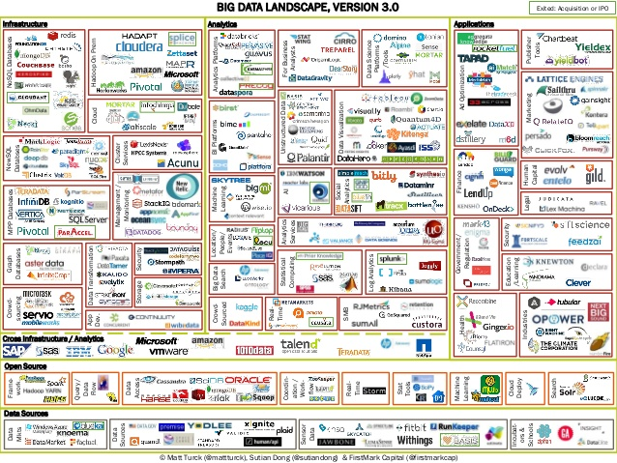
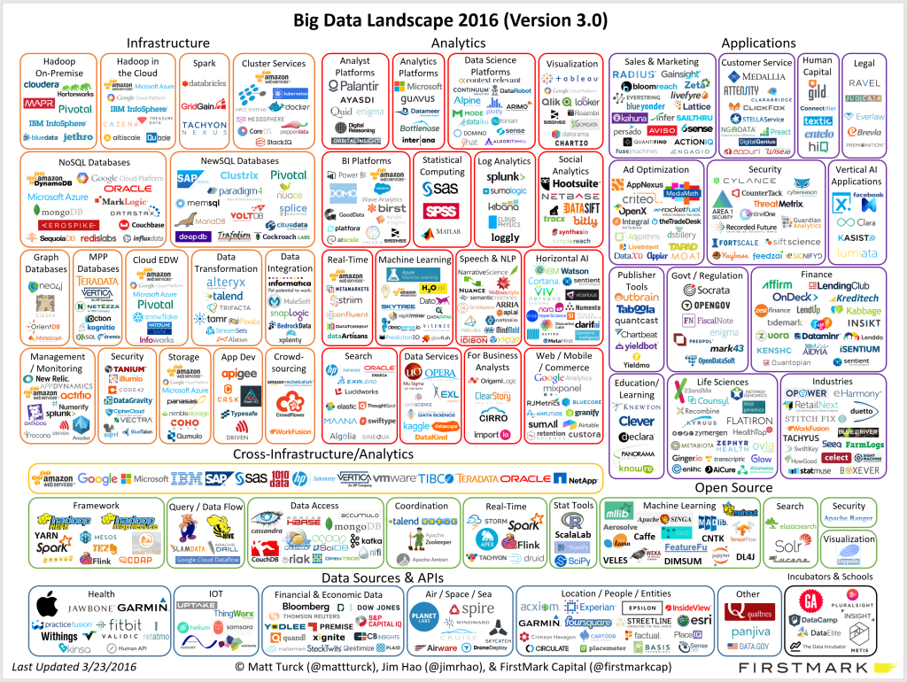
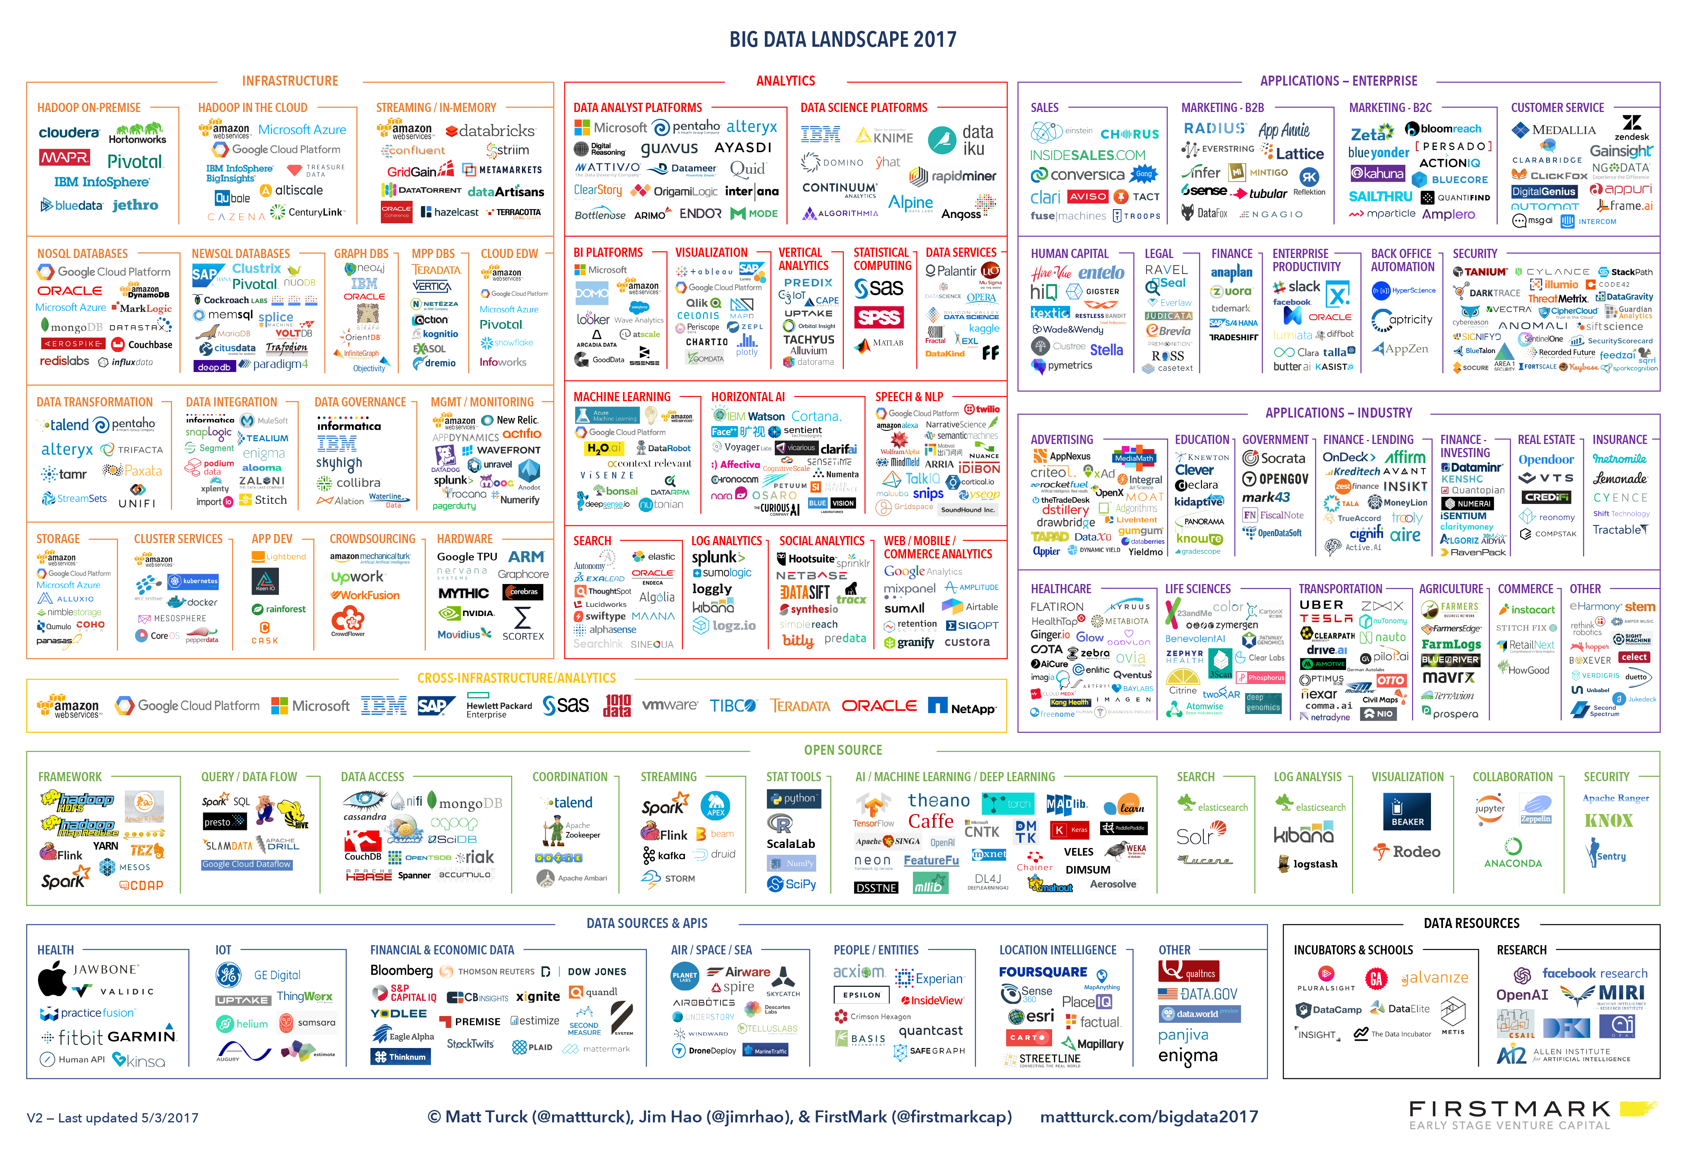
Big Data Landscape Evolution – A Moving Target
2014
2016
2017
Google Trends
Big Data
Machine Learning
Data Science
(Sources: Matt Turck - http://mattturck.com ; trends.google.ch)

Slide 6
Today’s Objectives
Get acquainted with the Big Data ecosystems
Find your way in the Big Data jungle, explore it more efficiently

Slide 7
Addressing the Big Data Challenges
cost
scale up
Bigger machines: scale up (a.k.a vertical scaling)
… the High Performance Computing way (HPC)
scale out
RAM
capability
Break the
CPU/RAM/Disk bounds
DISK
(…)
CPU
More machines: scale out (a.k.a horizontal scaling)
… the commodity hardware (cloud) way
Notes:
Scale UP (vertically), Scale Out (horizontally)
Scale out => many machines => distributed computation and distributed storage => framework to manage the distributed systems.

Slide 8
Addressing the Big Data Challenge
Horizontal scaling (scaling out) entails distributed computing across a large number of compute servers
Challenges of distributed computing are:
The same code should transparently work on 1, 10, or 10,000 servers
Assume problem can be broken down into chunks and each chunk calculated locally
The data must be accessible from anywhere
High availability: the systems must survive one or more server failures with no impact on operations
Resource utilization must be optimized
Minimize hot-spots with a good load-balancing strategy
Bring compute to data
The systems should support elastic scaling
Add/remove machines without requiring maintenance down-times

Slide 9
Addressing the Big Data Challenge - Solutions
Distributed Computing
Moving data around
Spark, MapReduce(2), Storm, TEZ, Flink, …
Kafka, Flume, Scoop, Nifi
Distributed Storage
Workflow orchestration
HDFS, Alluxio(Tachyon), Ceph, S3, GPFS, …
Oozie, …
Distributed data warehouses
Resource Management
Hive, SparkSQL, Hbase, Accumulo, Druid, Impala, Cassandra, MongoDB, CouchDB, Redis, Phoenix, JanusGraph, Neo4j, …
YARN, mesos, …
Provisioning, monitoring, management, security
End user interfaces
Ambari, Zookeeper, Ranger, Knox, …
Zeppelin, Jupyter Notebook, …
Data governance
Falcon, Atlas

Slide 10
Hadoop Distributed File Systems (HDFS) Essentials
What you need to know
NameNode: (master node) manage namespace, must have at least one, preferably two for high availability
DataNode: (worker node) serve the data, one per server
Write-once, you cannot modify a file in place (it must be replaced)
Data blocks are in units of 64MB (default)
Not for small files, use HDFS for large files only
Redundancy, all blocks replicated x3 (default)
Redundancy against failures
Statistically easier to move computation next to the data and load-balance the CPU usage
HDFS command line, with POSIX like interface (Hadoop2):
hdfs dfs [–help]
Notes:
[1] http://comphadoop.weebly.com/

Slide 11
Popular Big Data Formats
Big data components (Hive, Spark, etc) give you several formatting options for exchanging data, the most popular are
Plain text (csv, json, …)
Parquet:
column-oriented
integrated compression
ORC:
column-oriented in collections of rows, splittable by row collections
integrated compression
indexed
Avro:
row-oriented, splittable and support block compression
Notes:
index (
-

Slide 12
MapReduce in a Nutshell
Intermediate files on local file systems or in-memory
(key-value pairs)
1
1
1
2
4
1
1
4
2
1
3
3
1
2
2
1
1
2
Output
Input data (on HDFS)
Split
2
1
Reduce
Map
Shuffle
(key,value) pairs
Notes: (1) In HDFS the data is already ”split” into blocks and ”Mapping” can be done on all worker nodes where data blocks are located. However, beware of compressed data! not all compression algorithm are “splittable” in blocks, and MapReduce will not chunk it (splittable: bzip2, LZA, not splittable: gzip, snappy).
(2) shuffling is the network bottleneck of MapReduce operations, because placement of “reducers” cannot be optimized based on data locality.

Slide 13
The Clash: should I Stream, or should I Batch?
You want an updated answer as more information becomes available? streams
AKA: Data in motion, or Fast data
Continuous computation that never stop, process infinite amount of data on the fly
Designed to keep size of in-memory state bounded, regardless of how much data is processed
Update the answer as more data becomes available
Operate on small time windows
Can wait until all information is available for a more accurate answer? batch
AKA: Data at rest
Operates on finite size data sets, and terminate when all data has been processed

Slide 14
Big Data Illustrated – A Popular Real World Pattern
Real-time
Bus GPS Data
Data Stream
(Kafka)
Prediction
(Storm)
Bus ETA
Streams (continuous processing)
Model
Historical Data DBMS
(Hive)
Model Training
(Spark)
Import (Scoop)
Archives
Batch (e.g. learn a new model once a month)

Slide 15
Hadoop MapReduce Distributions
On-Premise (self-hosted) Big Data Distributions
Hortonworks Hadoop Distribution (used in this lab)
Cloudera Hadoop Distribution
MapR Hadoop Distribution
IBM Open Platform with Apache Hadoop
DC/OS, Mesosphere
…
Cloud-based (all-purposes) Big Data Platforms as a Service
EPFL IC Cluster (used in this lab)
Amazon EMR
Microsoft Azure HDInsight
Alibaba Cloud E-MapReduce
...
Notes:
They are like linux distributions, apache big data open sources with vendor-specific distinctive features added to it

Slide 16
This week’s exercises
Before you start confirm that you are listed in, and contact us if you are in the red groups:
https://git-dslab.epfl.ch/dslab2018/homework1-checkpoint/blob/master/homework1_report_21_03_2018.pdf
Get the DSLab Week 5 exercise instructions:
https://github.com/dslab2018/dslab2018.github.io/tree/master/labs/week5
Communications:
https://mattermost-dslab.epfl.ch
Remember we have office hours on Fridays for the graded projects

