Slide 1
Data science laboratory (DSLAB)
Dorina Thanou
Swiss Data Science Center
EPFL & ETH Zurich
Data Science Lab – Spring 2018

Slide 2
Start your engines!
Head over to the course webpage
https://dslab2018.github.io/
Configure & Run Oracle VirtualBox
Download, configure & start the DSLab VM
Ubuntu linux
Anaconda (Python 3), git, Docker/ pySpark, pyCharm
{username: student, password: student}
Notes:
Todays need:
- git
- docker

Slide 3
Solutions to Week #3
Any questions?

Slide 4
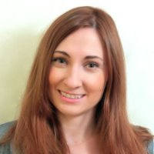
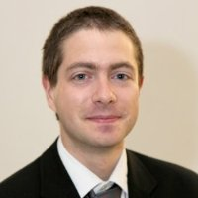
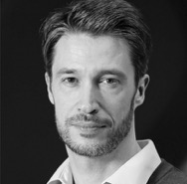
Today’s lab week #4 Dealing with real world sensor data

Slide 5
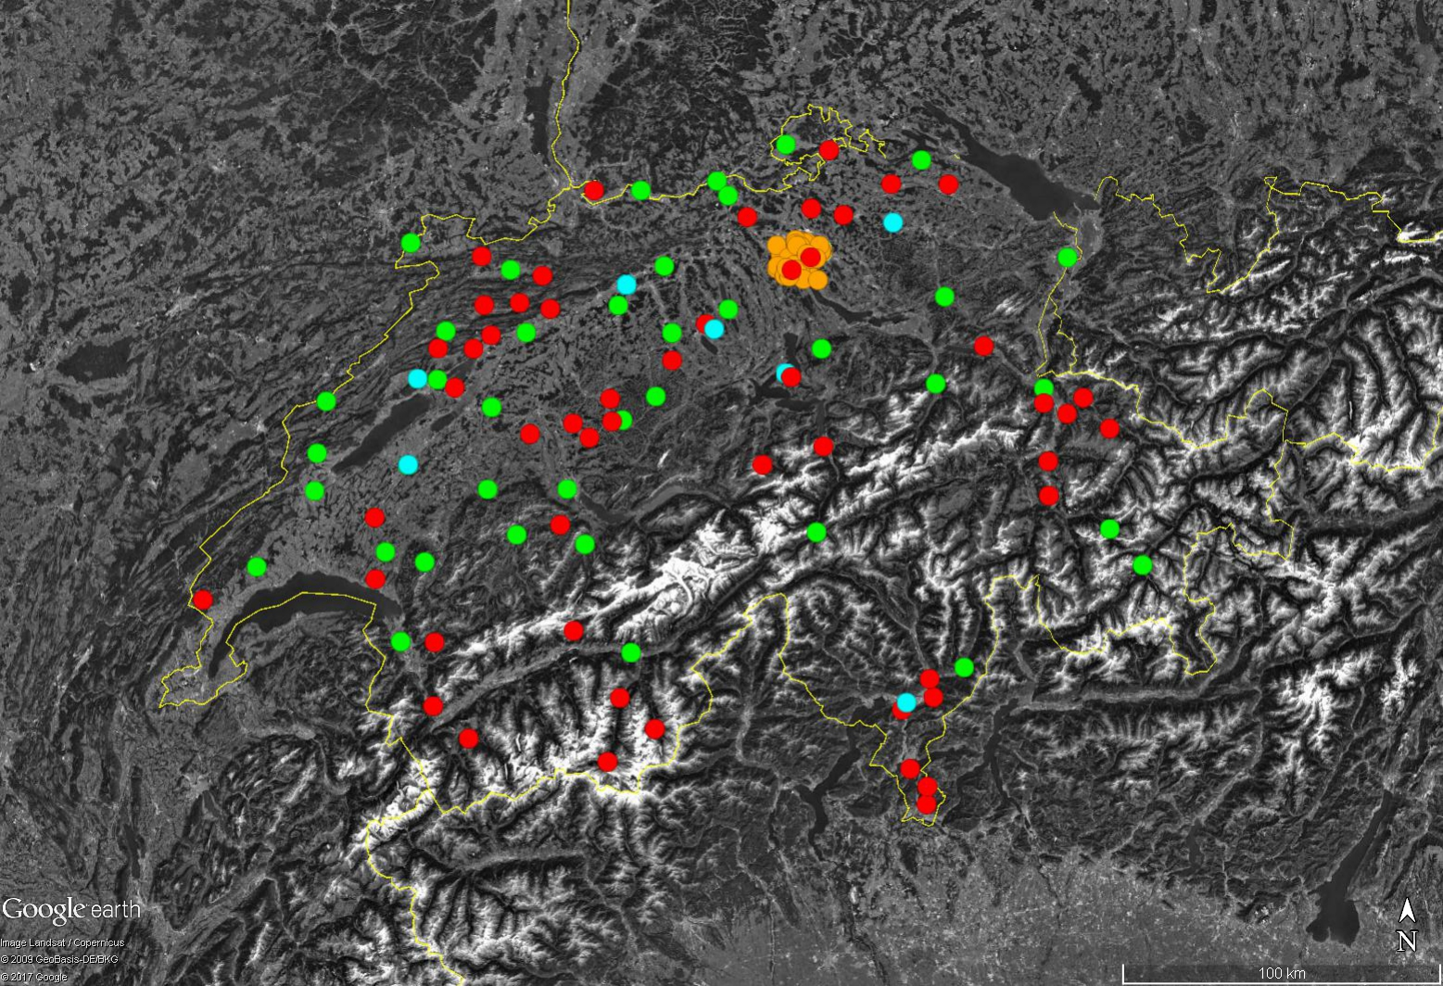
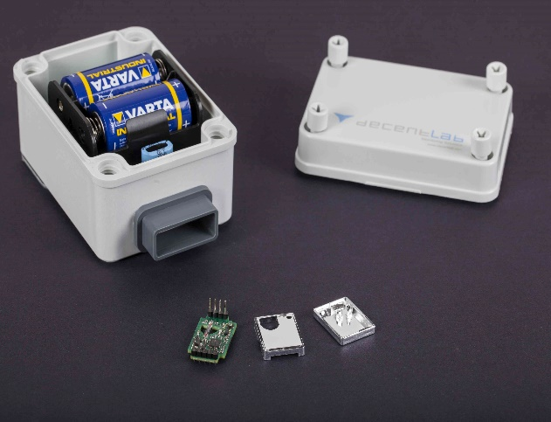
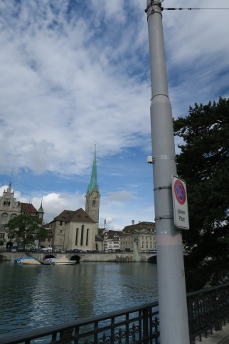
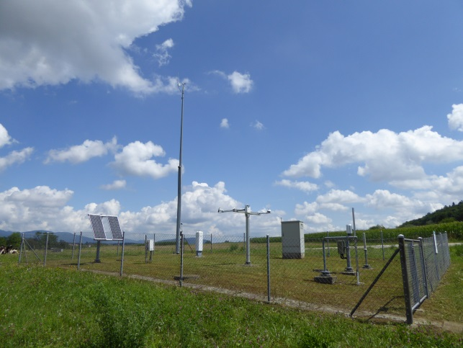
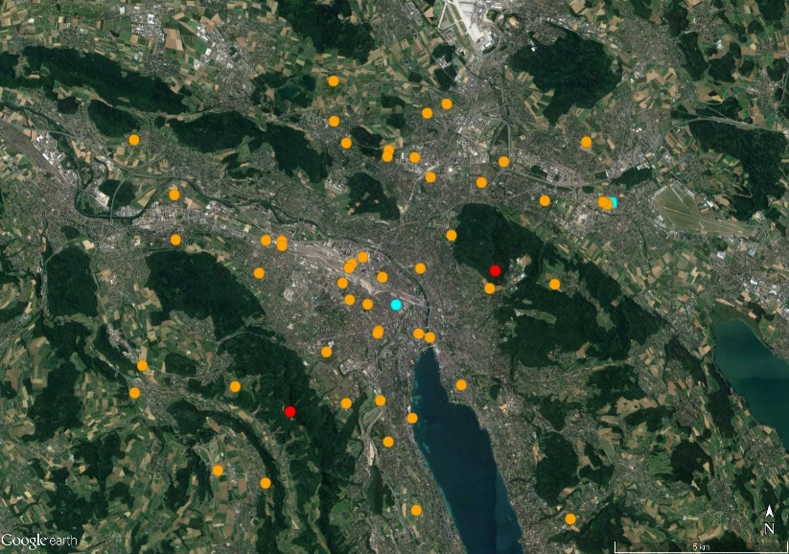
CarboSense: A low-cost low power CO2 network
Motivation
Improve the quantification of anthropogenic CO2 emissions and CO2 fluxes of the biosphere accounting for their high variability in space and time
Provide near-real time information on man-made emissions
Carbosense network (Nov 2017)
Sensor location in Zurich
MeteoSwiss site Wynau
Carbosense in Zurich
Different sensor units

Slide 6
CarboSense: Project Overview
http://carbosense.wikidot.com

Slide 7
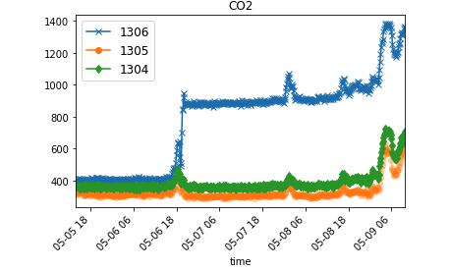
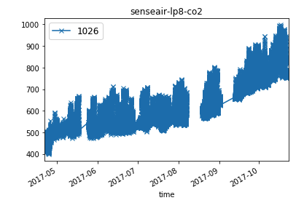
Sensors’ measurements
Inaccurate sensor measurements
All sensor devices have been calibrated (CO2, Temperature, Humidity) in climate and pressure chambers and under ambient conditions before deployment
Sensors behavior may change over time (sudden/single discontinuities, slower changes/drifts)
External parameters such as wind, traffic area, altitude may affect this change

Slide 8
Today’s lab
We will focus only in the area of Zurich
46 sites located in different part of the city
Measurements for each site
CO2 (ppm)
Temperature
Humidity
Additional metadata
Altitude at which each sensor is located
Average daily wind pattern for the city of Zurich
Division of the city into zones with different anthropogenic emissions (e.g., industrial, residential, forest, mountain, etc)

Slide 9
Objectives
Curate the CO2 measurements, by processing jointly the sensor measurements
Fit a robust regression model to the CO2 measurements, that takes into account all the different parameters
Use this model to detect possible inaccurate values
Prior knowledge
There is a strong dependence of the CO2 measurements, on temperature, humidity, altitude, traffic, wind etc.

Slide 10
Suggested spatio-temporal modeling
Detect similar patterns:
in time (days with similar characteristics)
in space (sensors with similar topological characteristics)
For each of these patterns learn a simple linear regression model
Example: Model the behavior of sensor A for the entire month
Step 1: Find other similar sensors (B, C)
Step 2: Find cluster of days with similar characteristics (D1, D2, D3)
Step 3: For all the days in Di use measurements from A, B, C to fit a regression model

Slide 11
Let’s get started
Get the DSLab Week 4 instructions
Please work in groups of two!
Due date: March 27 18H00
Office hours:
Friday March 16 15H00 – 16H00
Friday March 23 15H00 – 16H00
Communications:
https://mattermost-dslab.epfl.ch

