Slide 1
Data science laboratory (DSLAB)
Olivier Verscheure
Swiss Data Science Center
EPFL & ETH Zurich
Data Science Lab – Spring 2018

Slide 2
Start your engines!
Head over to the course webpage
https://dslab2018.github.io/
Configure & Run Oracle VirtualBox
Download, configure & start the DSLab VM
Ubuntu linux
Anaconda (Python 3), git, Docker, Spark / pySpark, pyCharm
{username: student, password: student}
Open a terminal
Run: ~ jupyter notebook
Notes:
pySpark: Spark Python API

Slide 3
Solutions to Week #1
https://dslab2018.github.io/notebooks/DSLab_week1_CCPython-Solution.ipynb
Any questions?
Notes:
pySpark: Spark Python API

Slide 4
Today’s lab week #2 numpy matplotlib pandas scikit-learn
Week 3
Week 4
Weeks 1 & 2

Slide 5
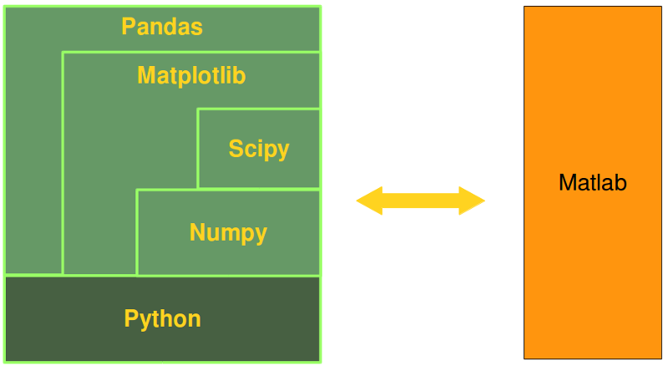
Python alternative to Matlab
Notes:
“Python in combination with Numpy, Scipy and Matplotlib can be used as a replacement for MATLAB. The combination of NumPy, SciPy and Matplotlib is a free alternative to MATLAB. Even though MATLAB has a huge number of additional toolboxes available, NumPy has the advantage that Python is a more modern and complete programming language and - as we have said already before - is open source. SciPy adds even more MATLAB-like functionalities to Python. Python is rounded out in the direction of MATLAB with the module Matplotlib, which provides MATLAB-like plotting functionality.”
Source: https://www.python-course.eu/numpy.php

Slide 6
NumPy & Data Types
Core library for scientific computing in Python
Provides a high-performance multidimensional array object, and tools for working with these arrays
A NumPy array (ndarray) is a grid of values, all of the same type
indexed by a tuple of nonnegative integers
the shape of an array is the size of the array along each dimension

Slide 7
Python lists vs NumPy arrays
Functionality: SciPy and NumPy have optimized functions such as linear algebra operations built in
Performance: need for speed and are faster than lists
Size: Numpy data structures take up less space
list: 64 + n*8 + n*28 bytes
ndarray: 96 + n*8 bytes
a.
b.
Notes:
Size - Numpy data structures take up less space
Performance - they have a need for speed and are faster than lists
Functionality - SciPy and NumPy have optimized functions such as linear algebra operations built in.
Python lists vs numpy arrays
Speed
import numpy as np
N = 1000
%%timeit
X = range(N)
Y = range(N)
#Z = [X[i]+Y[i] for i in range(len(X)) ] # slow
#Z = [ x+y for x,y in zip(X,Y) ] # fast
%%timeit
X = np.arange(N)
Y = np.arange(N)
Z = X + Y

Slide 8
Relevant NumPy functions
arange([start,] stop[, step], [, dtype=None])
linspace(start, stop, num=50, endpoint=True, retstep=False)
Checkout logspace & geomspace
reshape(array, newshape, order=‘C’)
copy(obj, order='K’)
Indexing and slicing arrays

Slide 9
What is Matplotlib?
Plotting library

Slide 10
Relevant Matplotlib functions
Functions: plot, subplot, scatter and annotate
%matplotlib {inline, notebook}
matplotlib.get_backend()

Slide 11
Other data visualization libraries
Seaborn: Python's Statistical Data Visualization Library
high-level interface to draw statistical graphics
https://seaborn.pydata.org/
Bokeh: Python interactive visualization library
interactive plots, dashboards, and data applications
https://bokeh.pydata.org/en/latest/

Slide 12
Pandas & Pandas Data Frames
Powerful & flexible data munging library
Pandas was built on NumPy
NumPy stores your data in arrays
Pandas takes the NumPy Array…
… and gives you a labeled index to it
Pandas DataFrame is a 2-D labeled data structure with columns of potentially different types
Basically, dictionary-based NumPy arrays
Recommended reading (before doing the exercises)
https://chrisalbon.com/python/data_wrangling/pandas_apply_operations_to_groups/
Notes:
Pandas makes the least sexy part of the "sexiest job of the 21st Century" a bit more pleasant.

Slide 13
scikit-learn: Machine Learning in Python
http://scikit-learn.org/stable/index.html
Open source, built on NumPy, SciPy, and matplotlib
Classification
Regression (Logistic Regression)
Clustering (KMeans)
Dimensionality reduction (PCA)
Model selection
Preprocessing
Notes:
Classification
Identifying to which category an object belongs to.
Regression
Predicting a continuous-valued attribute associated with an object.
Clustering
Automatic grouping of similar objects into sets.
Dimensionality reduction
Reducing the number of random variables to consider.
Model selection
Comparing, validating and choosing parameters and models.
Preprocessing
Feature extraction and normalization.

Slide 14
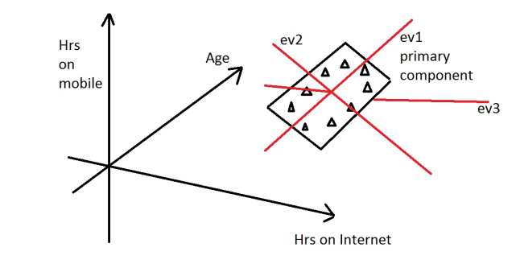
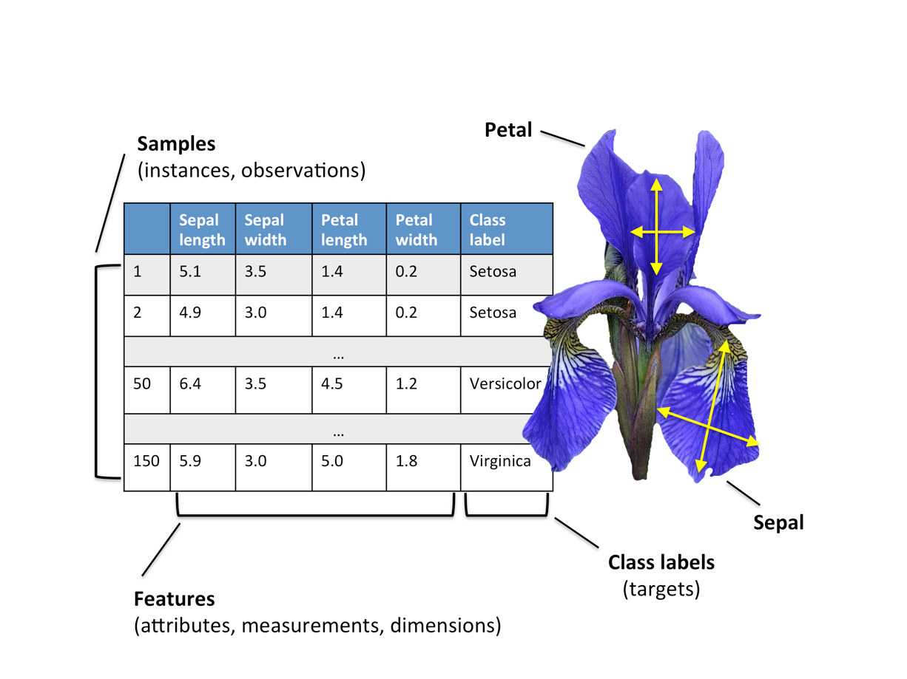
Principal Component Analysis (PCA)
sklearn.decomposition.PCA()
(Linear) dimensionality reduction using SVD of the data to project it to a lower dimensional space
Maximize the variance in the low-dimensional representation
Take e.g. the Iris dataset
Example
Notes:
Linear mapping of the data

Slide 15
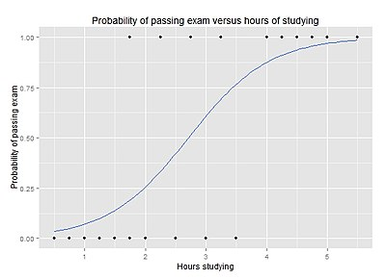
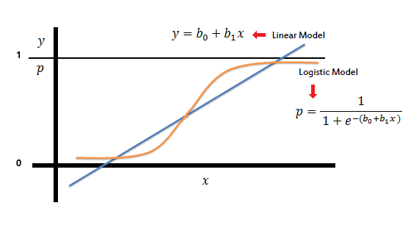
Logistic Regression
sklearn.linear_model.LogisticRegression()
Model used for prediction of the probability of occurrence of an event by fitting data to a logistic curve
Standard industry workhorse!
Chaining a PCA and a logistic regression
Notes:
supervised learning
developed by statistician David Cox in 1958
model is a direct probability model and not a classifier.
Fraud detection, product recommendation, etc

Slide 16
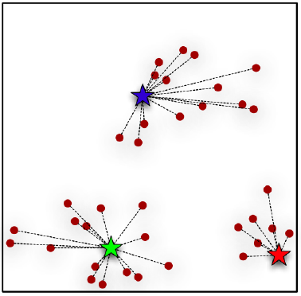
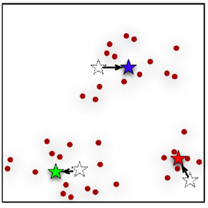
Kmeans – Clustering algorithm,
sklearn.cluster.KMeans()
Find similarity groups in a data, called clusters
Randomize K points, then two-step iterative algorithm:
1. Cluster assignment step
2. Move centroid step.
Notes:
unsupervised learning
Pick K
In Cluster assignment step, the algorithm goes through each of the data points and depending on which cluster is closer, whether the red cluster centroid or the blue cluster centroid or the green; It assigns the data points to one of the three cluster centroids.
In move centroid step, K-means moves the centroids to the average of the points in a cluster. In other words, the algorithm calculates the average of all the points in a cluster and moves the centroid to that average location.
repeated until there is no change in the clusters

Slide 17
This week’s exercises… a bit harder/longer
Download the DSLab Week 2 Jupyter notebooks
DSLab_week2_PythonDSLibs-NumPy_Matplotlib.ipynb
NumPy arrays & Matplotlib
DSLab_week2_PythonDSLibs-Pandas_sklearn.ipynb
Getting familiar with Pandas
Simple Machine Learning problems

Slide 18
Thank you!
http://www.datascience.ch
Twitter: @SDSCdatascience

