Slide 1
Final assignment Robust Journey Planning
Data Science Lab – Spring 2018

Slide 2
Start your engines!
Description of the final assignment
https://github.com/dslab2018/dslab2018.github.io/tree/master/labs/week12
Please check the webpage regularly as it will be updated over the next 3 weeks

Slide 3
Why robust journey planning?

Slide 4
Today’s assumption of a deterministic world
6 minutes to catch train in Morges
Meeting Zurich HB @ 10:30

Slide 5
Uncertainty-aware vs deterministic planning
Standard AO* fails to scale !
Weighted AO* with search enhancements
Pruning rules based on state dominance
Partial order reduction
Heuristics to guide search
ASM = Average savings per trip in minutes when differences occur
ASP = Average savings per trip as a percentage when differences occur
“Multi-Modal Journey Planning in the Presence of Uncertainty”, Adi Botea, Evdokia Nikolova, Michele Berlingerio. Twenty-Third International Conference on Automated Planning and Scheduling, 2013
Notes:
04/10/12
5
04/10/12
5

Slide 6
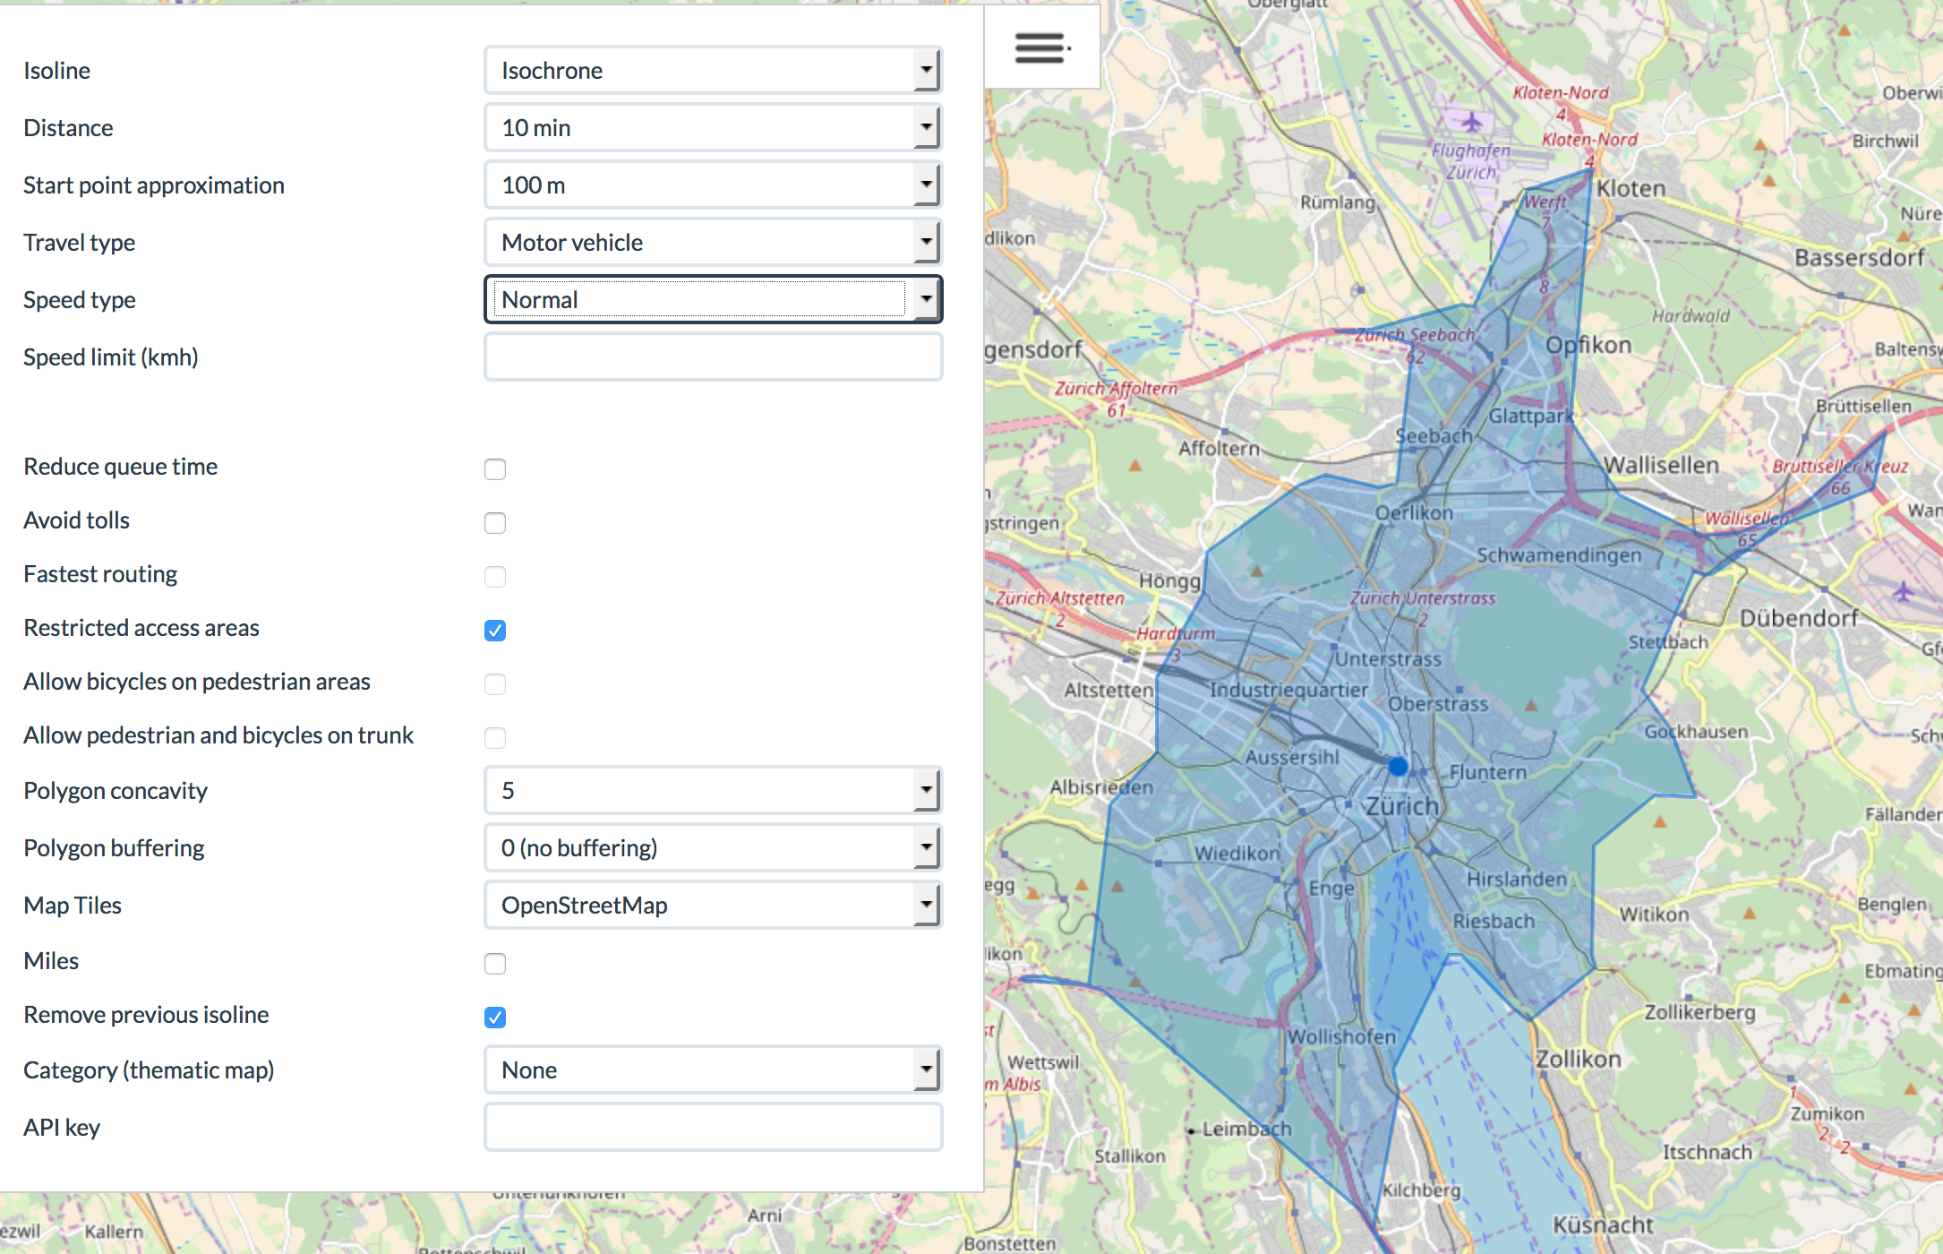
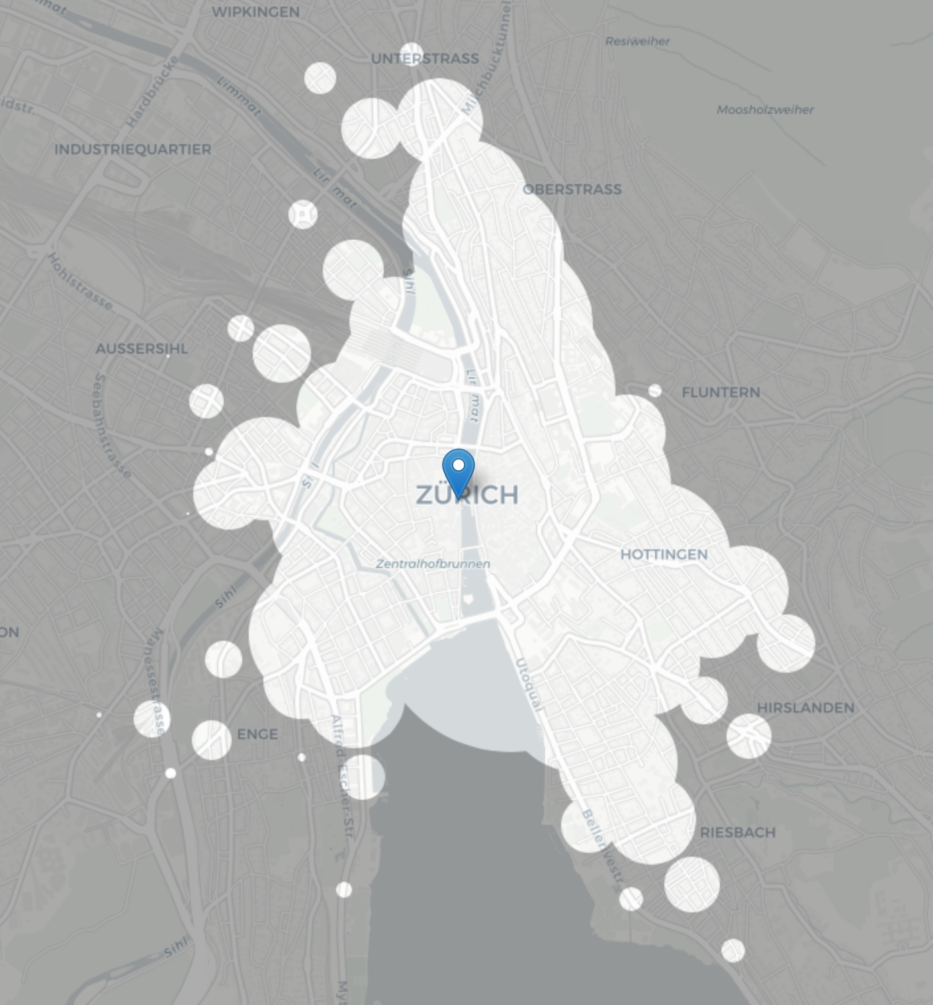
Assignment – overall objective
Display isochronous map Start of your Journey Zurich HB
Start your journey at Zurich HB
How far can you go within M minutes Q% of the time.

Slide 7
Milestones
Today’s tasks
Form the groups if not done
Understand the problem
Understand the data
Design statistical models
Week 1: Predictive models
Regression model for arrival / departure times
Week 2: Prescriptive models
Stochastic planner
Week 3: Validation and Visualization/UI

Slide 8
Guidance and supervision
Class hours
Wednesday 16th, 23rd, 30th
Office hours INN 211
Thursday May 17th 16:00 - 17:00
Tuesday May 22nd 15:00 - 16:00
Thursday May 31st 16:00 - 17:00
Communications:
https://mattermost-dslab.epfl.ch

